Slide 1

Geocoding for all: A subtle introduction to Geocoding
Taras Dubrava 30.05.2022

Slide 2
Agenda
What is Geocoding?
Geocode as
a Novice
an Advanced Beginner
a Competent
a Proficient
an Expert
Reverse geocoding in QGIS
Time to try geocoding in QGIS
Time to try geocoding with GeoPy

Slide 3
Unfortunately not covered today
The history of geocoding
Comparison of geocoders
Geocoding algorithms
Fuzzy logic
Apache Solr, ElasticSearch
Data Science and Machine Learning
Levenshtein distance
Geocoding in Data Bases
Coordinate Systems and Transformations
OpenStreetMap Philosophy
Setting an API key for a Geocoding API
File data types, encodings, and extensions
Python Essentials
Installation of Packages in Python
The concept of requests on the Internet
Proxy, certificate, SSL, TLS, HTTP/HTTPS

Slide 4
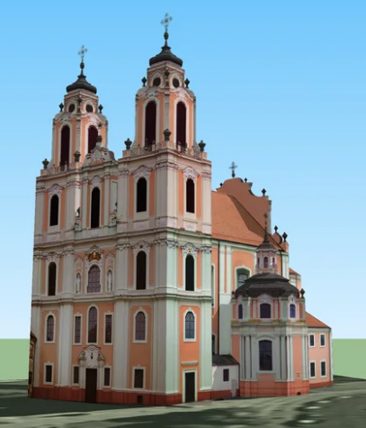
I. What is Geocoding?
Vilniaus g. 30, Vilnius 01119, Lithuania
Geocoding is a process of finding geographic coordinates for a physical (mailing) address.
A coordinates pair serves to identify a location on the Earth's surface.
synonyms : Forward geocoding, Address geocoding
Church of St. Catherine in Vilnius
Reverse geocoding is the process of converting coordinates to a human-readable address or place name.
Addresses provide a means of physically locating a building. It differs by country and area.
synonyms : Backward geocoding, Inverse geocoding
Latitude : 54.681778 Longitude : 25.281222

Slide 5
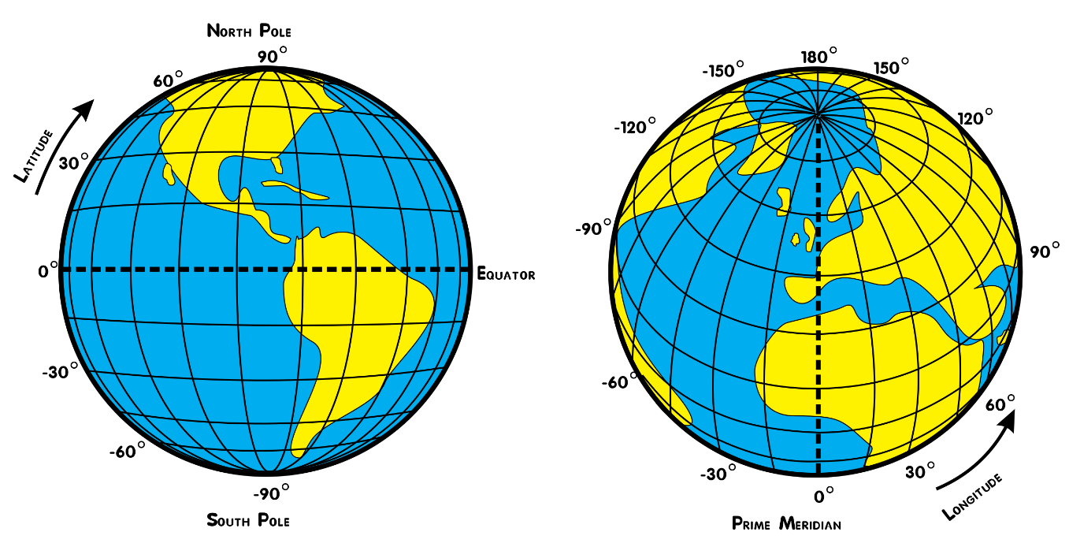
I. What is Geocoding?
Each address may (or may not) lead to a point (or several points) with latitude/y, longitude/x coordinates in decimal format.
All returned coordinates use WGS 84 (sometimes set as EPSG:4326 (https://epsg.org/crs_4326/WGS-84.html)) as Reference Coordinate System.
A geocoding procedure of many locations called batch geocoding.
In certain cases, geocoding by building's address can be problematic. A suggestion is to geocode by the place name (if it has one), e.g. Cathédrale Notre-Dame de Paris, 동대문 디자인 플라자, የኢትዮጵያ ብሔራዊ ሙዚየም, Catedral Metropolitana de la Ciudad de México, Akshardham etc.
The domains of geocoding application: GIS Analysis, Geomarketing, IT, Logistics and many others.

Slide 6
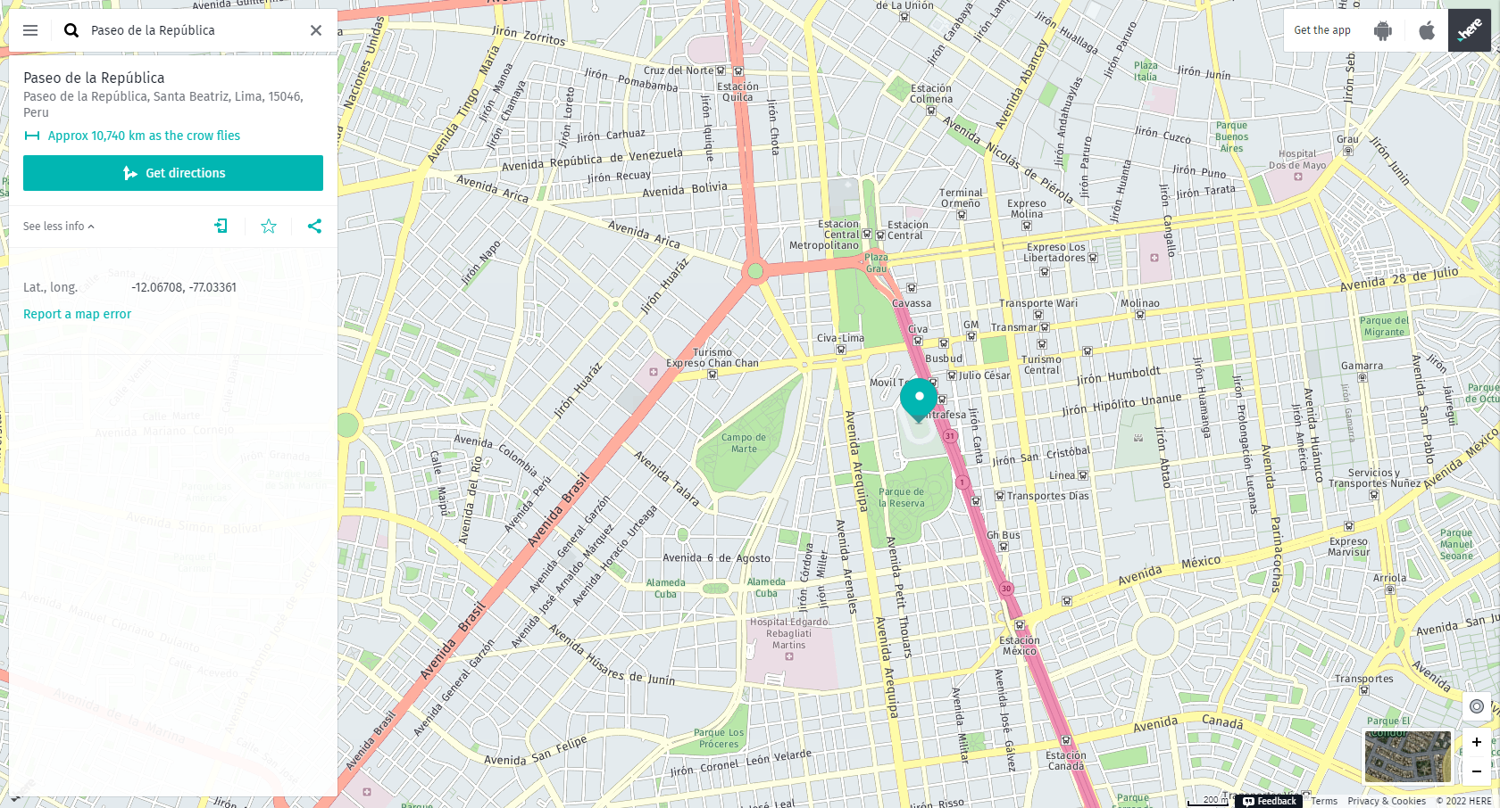


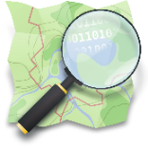



II. Geocode as a Novice 1) on the Internet : a Tiled Web Map service
The most commonly known TWM services possess a special searching field for locating either by an address (a place name) or coordinates.

Slide 7
II. Geocode as a Novice 1) on the Internet : a web page
There are some websites that offer geocoding solutions online:
https://geocode.localfocus.nl/
https://geocode.xyz/
https://www.gpsvisualizer.com/geocoder/
https://www.geocod.io/upload/
https://www.geoapify.com/tools/geocoding-online
https://www.latlong.net/
https://batchgeo.com/
https://geoservices.tamu.edu/Services/ReverseGeocoding/BatchProcess/
http://more.stevemorse.org/latlonbatch2.html?direction=forward
and many others …
Many of them may need an API key, otherwise can be open.
The majority normally support batch geocoding (e.g. via uploading a CSV file).

Slide 8
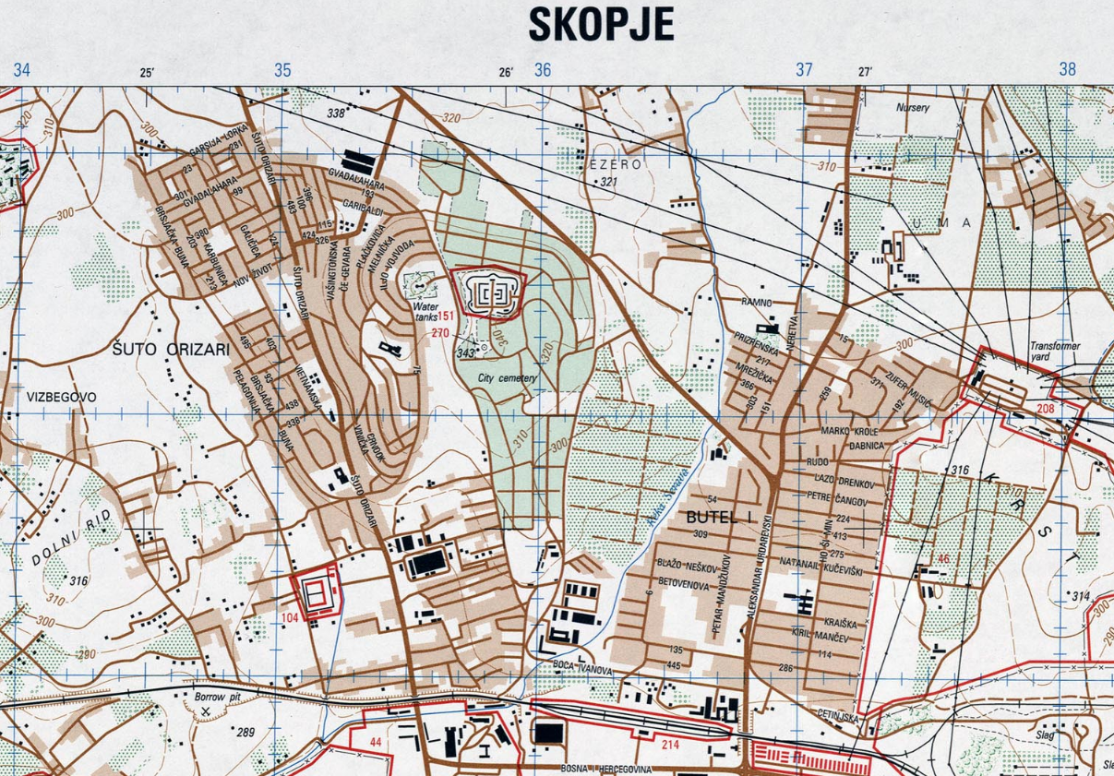
II. Geocode as a Novice 1) on a Map : geographic coordinates grids
A large scale (topographic) map or plan of a settlement is required
Buildings on the map have to have numbers as well streets have to be signed
A person needs to know how to determine the latitude and longitude of a point on the map
It is nice to have geographic coordinates grids, otherwise, a person will need to do much calculus

Slide 9
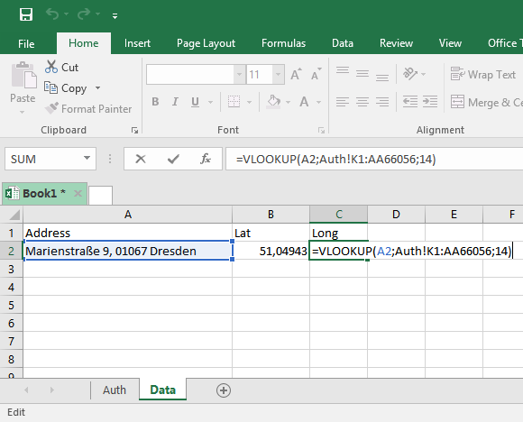
II. Geocode as an Advanced Beginner 2) with a spreadsheet : an offline pseudo geocoding with authoritative data in MS Excel
A simple workflow can look like:
Retrieve addresses from a credible data source, government open data
Bring your data with authoritative data in one document
Apply the VLOOKUP function
The data is reliable, the process is logical, but the result can be scarce.
For example, "Street" can be written by a user as a "Str.", "Str", "street", "STR.", "str." etc.

Slide 10
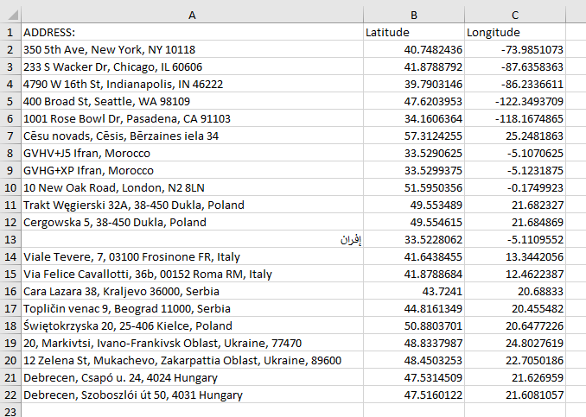
II. Geocode as an Advanced Beginner 2) with a spreadsheet : an integrated solution
There are several approaches available to deploying a geocoding service:
Use a finished solution:
http://excelgeocodingtool.com/
https://github.com/gramener/geocode-excel
https://www.adventuresincre.com/product/a-cre-geocoding-excel-add-in/
Power Map for MS Excel
Program a solution by yourself (requires certain VBA knowledge):
https://grindgis.com/software/microsoft-excel/geocoding-excel-and-google
https://www.mkrgeo-blog.com/the-costless-way-to-geocoding-addresses-in-excel-part-3-bulk-data-geocoding-with-nominatim-and-others-geocoding-tools/

Slide 11

II. Geocode as a Competent 3) using GIS Software : QGIS
Starting from QGIS 3.20 the Nominatim Geocoder comes on board. There are two features available:
a Nominatim locator filter
the "Batch Nominatim geocoder" processing tool for batch geocoding (converting addresses to coordinates). Placed in the Vector General of the Processing Toolbox.
Developer : @Mathieu Pellerin (https://github.com/nirvn)
The Nominatim (https://nominatim.org/) is under the hood.
Nominatim is a tool to search OpenStreetMap data by name and address and to generate synthetic addresses of OpenStreetMap points (reverse geocoding). No heavy uses (an absolute maximum of 1 request per second). The daily limit is 86400 requests (1sec * 60 * 60 * 24).

Slide 12
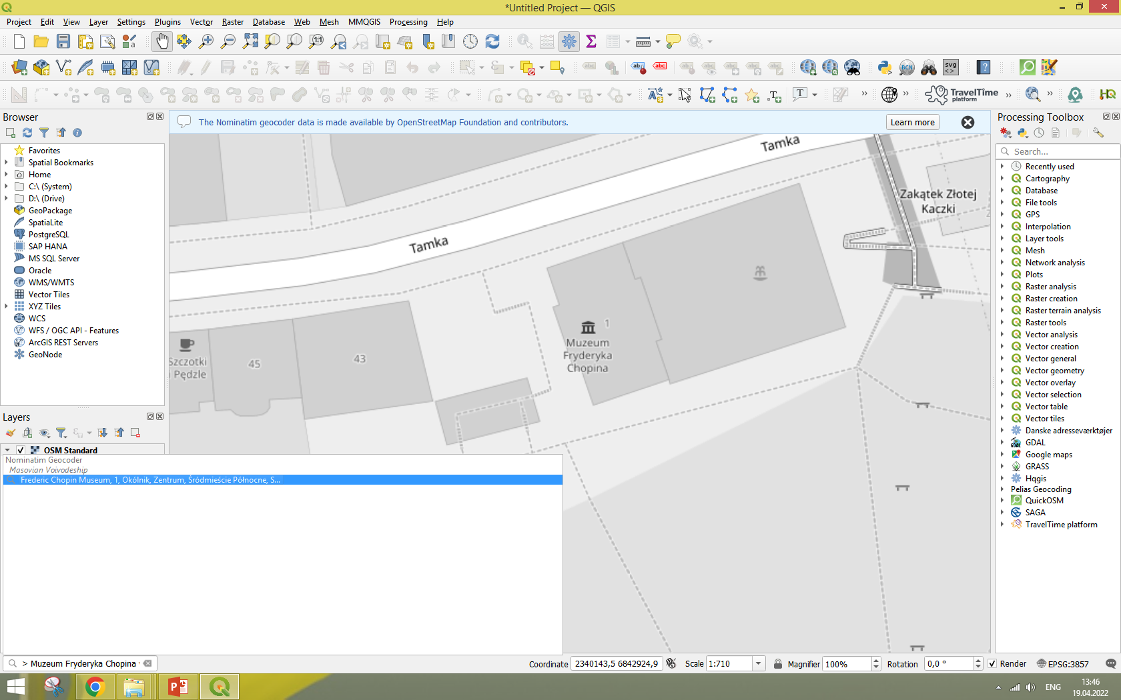
II. Geocode as a Competent 3) using GIS Software : QGIS
The Nominatim locator filter is embedded into the QGIS locator bar widget (by default, a search bar in the bottom left corner Ctrl + K)
For searches, use the prefix > >Muzeum Fryderyka Chopina w Warszawie
Works also with coordinates >52.236470, 21.022923
Similar to GeoCoding plugin, but it does not create a layer

Slide 13
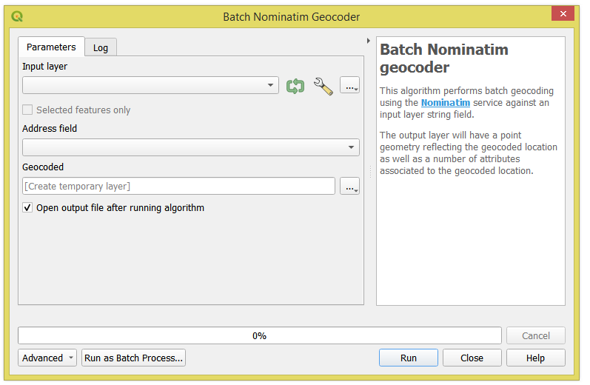
II. Geocode as a Competent 3) using GIS Software : QGIS
INPUT : a layer with a field that defines an address
OUTPUT : a point vector layer with original and several new fields
New Field(s) | Description
"osm_type" | reference to the OSM object
"display_name" | full comma-separated address
"place_id" | reference to the Nominatim internal database ID
"class", "type" | key and value of the main OSM tag
"road", "village", "city_district", "town", "city", "state", "country", "postcode" | address details

Slide 14
Q : What to do if you want more?
Simply saying: the Nominatim with OpenStreetMap is not enough

Slide 15
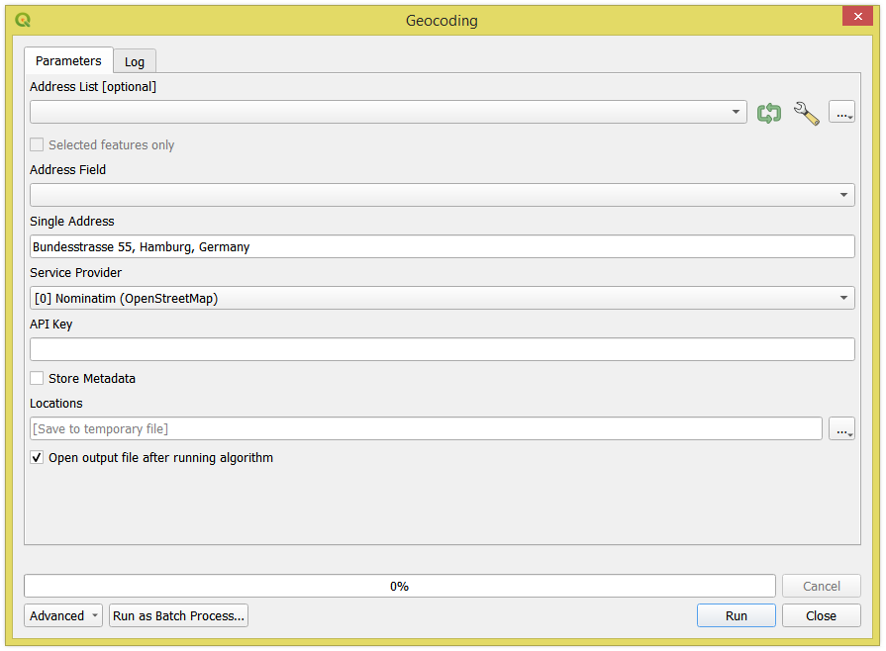

II. Geocode as a Competent 3) using add-ins in GIS Software
Another option is the "Geocoding" Tool from the SAGA provider.
It can be found in the SAGA's Import/Export – Web Services menu of the Processing Toolbox.
Contains five geocoding services: Nominatim, The Data Science Toolkit, Google Maps, Bing, and MapQuest.

Slide 16















II. Geocode as a Competent 3) using a Plugin in GIS Software
QGIS Plugins that perform geocoding: (searched by tags : geocode, geocoder, geocoding, address, locator)
GeoCoding
What3words Tools
MapTiler
Placekey - Address Matching and Entity Resolution
TravelTime platform Plugin
Hqgis
MMQGIS
TomTom Locator Filter
Pelias Geocoding
Nominatim Locator Filter
world
Google Maps Geocoder
local
PDOK Locatieserver Locator Filter
Digitransit.fi Geocoder
Geosearch DK
geopunt4Qgis
Geokodowanie Adresów UUG GUGiK
Estonian IN-ADS search
Danish Address Tools
OS search for addresses
Gban
French Locator Filter
GeoBarcelona
BKG Geocoder
French Address
Fonctions SIGMOÉ
Gazetteer Berlin/Brandenburg

Slide 17
26 QGIS Plugins that are available for geocoding : Part 1 (sorted by number of downloads)
# | Name | URLs | API key required | Downloads | Geocoder(s) | Batch | Reverse | Covered Area
1 | MMQGIS | https://plugins.qgis.org/plugins/mmqgis/ https://michaelminn.com/linux/mmqgis/ | no/yes | 1.107.363 | Nominatim, Google Maps, ESRI Server, US Census Bureau, NetToolKit | yes | yes | World
2 | GeoCoding | https://plugins.qgis.org/plugins/GeoCoding/ | no/yes | 291.063 | Nominatim, Google Maps | no | yes | World
3 | MapTiler | https://plugins.qgis.org/plugins/qgis-maptiler-plugin/ https://www.maptiler.com/qgis-plugin/ | yes | 97.269 | MapTiler Cloud API | no | yes | World
4 | geopunt4Qgis | https://plugins.qgis.org/plugins/geopunt4Qgis/ https://www.geopunt.be/over-geopunt/faq/plug-in | no | 94.293 | Geopunt API provided by the Flemish government Geographical Portal Geopunt | yes | yes | Flanders
5 | Geosearch DK | https://plugins.qgis.org/plugins/geosearch_dk/ https://dawadocs.dataforsyningen.dk/dok/api | no | 41.477 | DAWA's Datavask API | no | no | Denmark
6 | Nominatim Locator Filter | https://plugins.qgis.org/plugins/nominatim_locator_filter/ | no | 25.643 | Nominatim | no | yes | World
7 | TravelTime platform Plugin | https://plugins.qgis.org/plugins/travel_time_platform_plugin/ https://docs.traveltime.com/qgis/about/reference-manual | yes | 25.455 | The TravelTime platform API | yes | yes | World
8 | Hqgis | https://plugins.qgis.org/plugins/Hqgis/ https://developer.here.com/documentation/geocoding-search-api/dev_guide/index.html | yes | 24.123 | Here | yes | no | World
9 | Google Maps Geocoder | https://plugins.qgis.org/plugins/google_maps_geocoder/ https://developers.google.com/maps/documentation/geocoding/ | yes | 24.121 | Google Maps | yes | yes | World
10 | French Locator Filter | https://plugins.qgis.org/plugins/french_locator_filter/ https://oslandia.gitlab.io/qgis/french_locator_filter/ https://adresse.data.gouv.fr/api-doc/adresse | no | 19.140 | Etalab's Adresse API provided by the La direction interministérielle du numérique (DINUM) | no | no | France

Slide 18
26 QGIS Plugins that are available for geocoding : Part 2 (sorted by number of downloads)
# | Name | URLs | API key required | Downloads | Geocoder(s) | Batch | Reverse | Covered Area
11 | PDOK Locatieserver Locator Filter | https://plugins.qgis.org/plugins/pdok_locatieserver_locator_filter/ https://www.pdok.nl/pdok-locatieserver | no | 16.969 | PDOK Locatieserver | no | no | The Netherlands
12 | Gban | https://plugins.qgis.org/plugins/gban/ https://adresse.data.gouv.fr/api-doc/adresse | no | 8.705 | Etalab's Adresse API provided by the La direction interministérielle du numérique (DINUM) | no | yes | France
13 | Pelias Geocoding | https://plugins.qgis.org/plugins/PeliasGeocoding/ | yes | 8.588 | Openrouteservice, Geocode Earth | yes | yes | World
14 | French Address | https://plugins.qgis.org/plugins/french_address/ https://adresse.data.gouv.fr/api-doc/adresse | no | 8.167 | Etalab's Adresse API provided by the La direction interministérielle du numérique (DINUM) | no | yes | France
15 | Geokodowanie Adresów UUG GUGiK | https://plugins.qgis.org/plugins/geokodowanie_adresow/ http://services.gugik.gov.pl/uug/ | no | 5.593 | Uniwersalna Usługa Geokodowania (UUG) provided by the Główny Urząd Geodezji i Kartografii (GUGiK) | yes | no | Poland
16 | BKG Geocoder | https://gdz.bkg.bund.de/index.php/default/qgis-bkg-geocoder.html https://plugins.qgis.org/plugins/bkggeocoder/ | yes | 3.484 | BKG Geocoder provided by the Bundesamt für Kartographie und Geodäsie | yes | yes | Germany
17 | GeoBarcelona | https://plugins.qgis.org/plugins/geobarcelona/ https://w33.bcn.cat/GeoBcn | no | 2.754 | GeoBcn provided by the l'Ajuntament de Barcelona | no | no | Barcelona
18 | Danish Address Tools | https://plugins.qgis.org/plugins/AddressToolsDK/ https://dawadocs.dataforsyningen.dk/dok/api | no | 2.066 | DAWA's Datavask API | yes | no | Denmark
19 | Fonctions SIGMOÉ | https://plugins.qgis.org/plugins/SgmExpressionFunctions/ https://adresse.data.gouv.fr/api-doc/adresse | no | 1.868 | Etalab's Adresse API provided by the La direction interministérielle du numérique (DINUM) | yes | yes | France

Slide 19
26 QGIS Plugins that are available for geocoding : Part 3 (sorted by number of downloads)
# | Name | URLs | API key required | Downloads | Geocoder(s) | Batch | Reverse | Covered Area
20 | OS search for addresses | https://plugins.qgis.org/plugins/addresssearch/ https://osdatahub.os.uk/ | yes | 1.622 | OS Data Hub Place API | no | no | The UK
21 | TomTom Locator Filter | https://plugins.qgis.org/plugins/tomtom_locator_filter/ https://developer.tomtom.com/search-api/documentation/product-information/introduction | yes | 1.106 | TomTom's Search API | no | yes | World
22 | Digitransit.fi Geocoder | https://digitransit.fi/en/developers/apis/2-geocoding-api/ https://plugins.qgis.org/plugins/QGISDigitransitGeocoding-master/ | no | 1.043 | Digitransit.fi geocoding API | no | no | Finnland
23 | Placekey - Address Matching and Entity Resolution | https://plugins.qgis.org/plugins/placekey/ https://www.placekey.io/ | yes | 871 | The Placekey API | yes | yes | The Netherlands The US, Canada
24 | What3words Tools | https://plugins.qgis.org/plugins/what3words/ https://developer.what3words.com/tools/gis-extensions/qgis | yes | 375 | what3words API | yes | yes | World
25 | Gazetteer Berlin/Brandenburg | https://plugins.qgis.org/plugins/qgs-gazetteer-bb/ https://search.geobasis-bb.de/ | no | 328 | Search API provided by the Landesvermessung und Geobasisinformation Brandenburg | no | no | Berlin and Brandenburg
26 | Estonian IN-ADS search | https://plugins.qgis.org/plugins/in_ads/ https://geoportaal.maaamet.ee/eng/Services/In-ADS-p660.html | no | 234 | In-ADS API | no | no | Estonia

Slide 20
II. Geocode as a Proficient 4) with GIS Software API : PyQGIS
This snippet of code can be used for geocoding with the "Batch Nominatim geocoder" processing algorithm using PyQGIS
import processing
layer = qgis.utils.iface.activeLayer()
result = processing.run("native:batchnominatimgeocoder",
{'INPUT': layer, 'FIELD': "address", 'OUTPUT': 'memory:'})
QgsProject.instance().addMapLayer(result['OUTPUT'])

Slide 21
II. Geocode as a Proficient 4) with GIS Software API : PyQGIS
Surprisingly but starting from QGIS 3.18 already had two embedded API geocoder classes:
QgsNominatimGeocoder : https://qgis.org/pyqgis/master/core/QgsNominatimGeocoder.html
QgsGoogleMapsGeocoder : https://qgis.org/pyqgis/master/core/QgsGoogleMapsGeocoder.html
Also developed by @Mathieu Pellerin (https://github.com/nirvn).
Keep in mind : To deploy the Google Maps geocoding API's class the apiKey argument must be provided.

Slide 22
II. Geocode as a Proficient 4) with GIS Software API : PyQGIS
QgsNominatimGeocoder
QgsGoogleMapsGeocoder
Methods in common:
appendedFields, flags, geocodeFeature, geocodeString, jsonToResult, requestUrl, setEndpoint, wkbType
Unique methods:
countryCodes, endpoint, requestsPerSecond, setCountryCodes, setRequestsPerSecond
Unique methods:
apiKey, region, setApiKey, setRegion
Both classes can be imported from the qgis.core from qgis.core import QgsNominatimGeocoder from qgis.core import QgsGoogleMapsGeocoder
The usage of several additional classes may be useful/required :
QgsGeocoderContext : https://api.qgis.org/api/classQgsGeocoderContext.html
QgsCoordinateTransformContext : https://api.qgis.org/api/classQgsCoordinateTransformContext.html
QgsGeocoderLocatorFilter : https://api.qgis.org/api/classQgsGeocoderLocatorFilter.html
QgsAbstractGeocoderLocatorFilter : https://api.qgis.org/api/classQgsAbstractGeocoderLocatorFilter.html

Slide 23
II. Geocode as a Proficient 4) with GIS Software API : PyQGIS
A working example of how to use each of the geocoder class
QgsNominatimGeocoder
QgsGoogleMapsGeocoder
from qgis.core import (QgsNominatimGeocoder,
QgsGeocoderContext,
QgsCoordinateTransformContext)
address = 'Trachenberger Str. 38, 01129 Dresden, Germany'
geocoder = QgsNominatimGeocoder()
context = QgsGeocoderContext(QgsCoordinateTransformContext())
output = geocoder.geocodeString(address, context, feedback=None)
methods_for_geocoder_result = [ 'additionalAttributes', 'crs', 'geometry', 'isValid', 'description', 'error', 'group', 'identifier' ]
for out in output:
for method in methods_for_geocoder_result:
print(method, getattr(out, method)())
from qgis.core import (QgsGoogleMapsGeocoder,
QgsGeocoderContext,
QgsCoordinateTransformContext)
address = 'Trachenberger Str. 38, 01129 Dresden, Germany'
geocoder = QgsGoogleMapsGeocoder(apiKey='***')
context = QgsGeocoderContext(QgsCoordinateTransformContext())
output = geocoder.geocodeString(address, context, feedback=None)
methods_for_geocoder_result = [ 'additionalAttributes', 'crs', 'geometry', 'isValid', 'description', 'error', 'group', 'identifier' ]
for out in output:
for method in methods_for_geocoder_result:
print(method, getattr(out, method)())

Slide 24

II. Geocode as a Proficient 4) with GIS Software API : PyQGIS
The Nominatim geocoder can sometimes be a bit complex ...
QgsNominatimGeocoder
QgsGoogleMapsGeocoder
additionalAttributes {'city': 'Dresden', 'city_district': 'Pieschen', 'class': 'tourism', 'country': 'Germany', 'display_name': 'Straßenbahnmuseum Dresden e.V., Trachenberger Straße, Pieschen-Nord/Trachenberge, Pieschen, Dresden, Saxony, 01129, Germany', 'osm_type': 'node', 'place_id': '1319654', 'postcode': '01129', 'road': 'Trachenberger Straße', 'state': 'Saxony', 'type': 'museum'}
crs <QgsCoordinateReferenceSystem: EPSG:4326>
geometry <QgsGeometry: Point (13.72919160000000005 51.08626329999999882)>
isValid True
description
error
group Saxony
identifier Straßenbahnmuseum Dresden e.V., Trachenberger Straße, Pieschen-Nord/Trachenberge, Pieschen, Dresden, Saxony, 01129, Germany
additionalAttributes {'administrative_area_level_1': 'Sachsen', 'country': 'Deutschland', 'formatted_address': 'Trachenberger Str. 38, 01129 Dresden, Deutschland', 'locality': 'Dresden', 'location_type': 'ROOFTOP', 'place_id': 'ChIJMXG36v_OCUcRcu7kfljCywM', 'postal_code': '01129', 'route': 'Trachenberger StraÃŸe', 'street_number': '38'}
crs <QgsCoordinateReferenceSystem: EPSG:4326>
geometry <QgsGeometry: Point (13.7295777999999995 51.08656100000000322)>
isValid True
description
error
group Sachsen
identifier Trachenberger Str. 38, 01129 Dresden, Deutschland
additionalAttributes {'city': 'Dresden', 'city_district': 'Pieschen', 'class': 'building', 'country': 'Germany', 'display_name': '38, Trachenberger Straße, Pieschen-Nord/Trachenberge, Pieschen, Dresden, Saxony, 01129, Germany', 'osm_type': 'way', 'place_id': '106533175', 'postcode': '01129', 'road': 'Trachenberger Straße', 'state': 'Saxony', 'type': 'industrial'}
crs <QgsCoordinateReferenceSystem: EPSG:4326>
geometry <QgsGeometry: Point (13.72950708533253916 51.08659294999999645)>
isValid True
description
error
group Saxony
identifier 38, Trachenberger Straße, Pieschen-Nord/Trachenberge, Pieschen, Dresden, Saxony, 01129, Germany
P.S. To avoid ambiguity for Nominatim result use a filter : out.additionalAttributes()['class'] == 'building'

Slide 25







II. Geocode as a Proficient 4) using a Geocoding API
There are plenty of geocoding APIs (geocoders) maintained by the mapping services:
Google Maps https://developers.google.com/maps/documentation/geocoding
ArcGIS https://developers.arcgis.com/documentation/mapping-apis-and-services/search/
Bing Maps https://docs.microsoft.com/en-us/bingmaps/rest-services/locations/?redirectedfrom=MSDN
TomTom https://developer.tomtom.com/products/places-api
HERE https://developer.here.com/c/geocoding
MapBox https://docs.mapbox.com/playground/geocoding/
MapTiler https://www.maptiler.com/cloud/geocoding/
Precisely https://www.precisely.com/product/precisely-spectrum-geocoding/spectrum-geocoding
OpenCage https://opencagedata.com/api
OpenWeather https://openweathermap.org/api/geocoding-api
Positionstack https://positionstack.com/
MapLarge https://www.maplarge.com/developer/geocoderapi

Slide 26
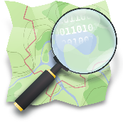





II. Geocode as a Proficient 4) using a Geocoding API
There are also some free geocoding APIs (geocoders):
However, keep in mind, that many "not free" geocoding APIs have "a free" subscription plan.
It may be limited in terms of the number of requests per day/per second, the purpose of usage, level of support from the provider, variety of response formats, CORS restriction, IP restrictions, number of end-users and other restraints.
However, it might be enough for your personal (testing) purposes.
Also, pay attention to the Terms of Use and Privacy Policies, and the License Restrictions.
Nominatim https://nominatim.org/
Gisgraphy https://www.gisgraphy.com/index.php
GeoNames http://www.geonames.org/export/
MapQuest https://developer.mapquest.com/documentation/open/
API Adresse https://adresse.data.gouv.fr/api-doc
BKG Geocoder https://gdz.bkg.bund.de/index.php/default/webanwendungen/bkg-geocoder.html
Census Geocoder https://www.census.gov/programs-surveys/geography/technical-documentation/complete-technical-documentation/census-geocoder.html

Slide 27

II. Geocode as an Expert 5) by means of Python : GeoPy
Many packages available on the The Python Package Index (PyPI): https://pypi.org/search/?q=geocoding
295 projects for "geocoding"
50 projects for "geocoding" with the "Production/Stable" Status
A personal suggestion : GeoPy is a Python client for several popular geocoding web services. Documentation : https://geopy.readthedocs.io/en/stable/

Slide 28
II. Geocode as an Expert 5) by means of Python : GeoPy
Advantages:
Well documented
Compatible with Pandas
All geocoders can be deployed with the asyncio Python library, to make them work asynchronous, by default they work synchronous
The GeoPy embraces a tremendous list of geolocation services : AlgoliaPlaces, ArcGIS, AzureMaps, Baidu, BaiduV3, BANFrance, Bing, DataBC, GeocodeEarth, GeocodeFarm, Geocodio, Geolake, GeoNames, GoogleV3, HERE, HEREv7, IGNFrance, MapBox, MapQuest, MapTiler, OpenCage, OpenMapQuest, Nominatim, Pelias, Photon, PickPoint, LiveAddress, TomTom, What3Words, and What3WordsV3
Moreover, for each geocoder it will be always a parsed geocoder response with: an address, latitude, longitude, and raw output.
Can be used for calculating geodesic distance between two points using multiple popular ellipsoidal models
Can be integrated into QGIS

Slide 29

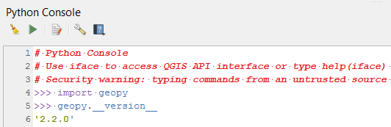
II. Geocode as an Expert 5) by means of Python : QGIS meets GeoPy
GeoPy (after installation), like many other Python Packages, can be called in QGIS 3
It can be used for creating own functions for geocoding, e.g. in the Function Editor

Slide 30
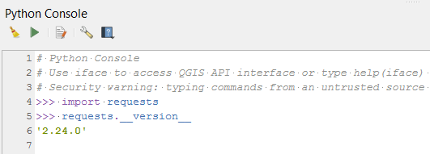

II. Geocode as an Expert 5) by means of Python : QGIS carries requests
There is another useful Python Package which is already included in QGIS.
Requests: HTTP for Humans™ - it is an elegant and simple HTTP library for Python.
Documentation : https://docs.python-requests.org/en/latest/
For example: a request to the Nominatim geocoder
r = requests.get('https://nominatim.openstreetmap.org/search?<params>')

Slide 31


II. Geocode as a God : ☺
Use Pelias locally (on your machine or your own server) inside a Docker container image.
Pelias is a geocoder powered completely by open data, available freely to everyone.
A Docker container image is a lightweight, standalone, executable package of software that includes everything needed to run an application: code, runtime, system tools, system libraries and settings.

Slide 32
III. Reverse geocoding in QGIS
There are several ways exist to get an address from a tuple of coordinates :
Use a Plugin
Join address to the input layer by nearest from an authoritative data source (i.e. open data from the government). The "Join attributes by nearest" geoalgorithm placed in the Vector General of the Processing Toolbox. Alternatively there is a special function called overlay_nearest()
Write a custom function for reverse geocoding with GeoPy/requests in the Function Editor

Slide 33
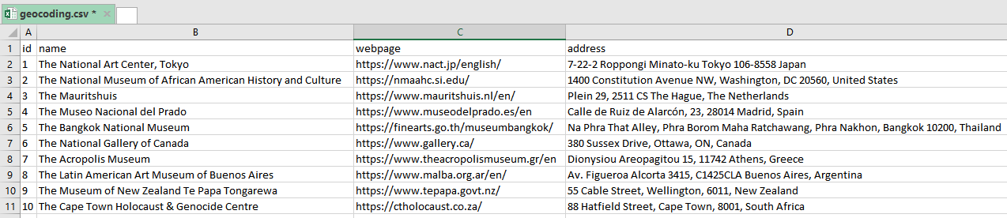
IV. Time to try geocoding in QGIS
There is a CSV file called "geocoding.csv" (encoded in UTF-8) with some information about 10 museums taken randomly around the world, see the image below.
Each address was taken from a museum's official page.

Slide 34
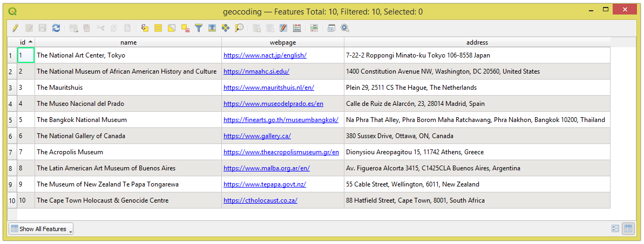
IV. Time to try geocoding in QGIS
Now let's geocode this CSV file with the "Batch Nominatim geocoder" processing tool. And then explore/assess the results.
To each record, it will be referred by its "id".
Be attentive to bring the CSV file with the UTF-8 encoding.
Double check it via Properties > Source > Data source encoding.

Slide 35
Inspecting the results after geocoding in QGIS
id | Result description | Failure : Data from the original source | Success : Data from OSM | Better approach : geocode by name
1 | No result – 0% | 7-chōme-22-2 Roppongi, Minato City, Tokyo 106-8558, Japan | The National Art Center, Roppongi 7-chome, Roppongi, Azabu, Minato, Tokyo, 106-0033, Japan https://nominatim.openstreetmap.org/ui/details.html?osmtype=W&osmid=136048451&class=building | The National Art Center, Tokyo
2 | Done – 100% | - | - | NMAAHC
3 | No result – 0% | Plein 29, 2511 CS The Hague, The Netherlands | Plein 29, 2511CS The Hague, The Netherlands https://nominatim.openstreetmap.org/ui/details.html?osmtype=N&osmid=2718100253&class=place | The Mauritshuis
4 | Biased – 40% 35 km away in Meco | Calle de Ruiz de Alarcón, 23, 28014 Madrid, Spain | Calle Ruiz de Alarcón, 23, 28014 Madrid, Spain https://nominatim.openstreetmap.org/ui/details.html?osmtype=R&osmid=7726080&class=tourism | Museo del Prado
5 | No result – 0% | Na Phrathat Road, Grand Palace sub district, Phra Nakorn district, Bangkok 10200, Thailand | Bangkok National Museum, Na Phra That Road, Tha Pra Chan, Phra Borom Maha Ratchawang Subdistrict, Phra Nakhon District, Bangkok, 10200, Thailand https://nominatim.openstreetmap.org/ui/details.html?osmtype=W&osmid=178329971&class=tourism | Bangkok National Museum
6 | Done – 100% | - | - | National Gallery of Canada
7 | Done – 100% | - | - | Acropolis Museum
8 | Biased – 60% 23 km away in Castelar | Av. Figueroa Alcorta 3415 C1425CLA Buenos Aires, Argentina | Museo de Arte Latinoamericano de Buenos Aires, 3415, Avenida Presidente Figueroa Alcorta, Barrio Parque, Palermo, Buenos Aires, Comuna 14, Autonomous City of Buenos Aires, C1425CLA, Argentina https://nominatim.openstreetmap.org/ui/details.html?osmtype=W&osmid=23621021&class=tourism | Museo de Arte Latinoamericano de Buenos Aires
9 | Done – 100% | - | - | Te Papa
10 | Biased – 90% 60 m away | 88 Hatfield Street, Cape Town, 8001, South Africa | Cape Town Holocaust Centre, Saint Johns Road, City Centre, Cape Town, City of Cape Town, Western Cape, 8001, South Africa https://nominatim.openstreetmap.org/ui/details.html?osmtype=W&osmid=203346850&class=tourism | Cape Town Holocaust Centre

Slide 36
Suggestions for Geocoding in QGIS with the "Batch Nominatim geocoder" processing tool
Geocoding by POI's name (if it has one) can be much more robust
An address from the official resource does not particularly mean that it is a valid address for Nominatim/OSM
Better to double-check doubtful addresses in the Nominatim: https://nominatim.openstreetmap.org/ui/search.html
Tiny things matter
Expect that there can be poor as well as empty outputs

Slide 37
V. Time to try geocoding with GeoPy
There is a CSV file called "geocoding.csv" (encoded in UTF-8) with some information about 10 museums taken randomly around the world, see the image below.
Each address was taken from a museum's official page.

Slide 38
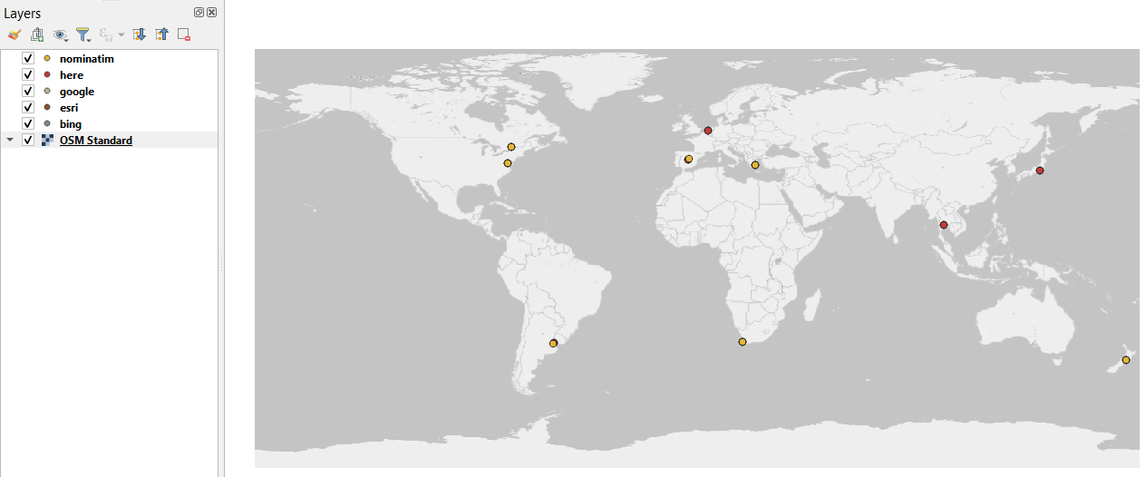
V. Time to try geocoding with GeoPy
Now let's geocode this CSV file with the GeoPy using five geocoders: ArcGIS, Bing, GoogleV3, Here, and Nominatim.
And then explore/assess each result in QGIS. To each record, it will be referred by its "id".
The initial CSV file was read as a DataFrame by means of pandas.
Afterwards gocoder was applied, and then each DataFrame was exported again into a new CSV file. To be able to import it as Delimited Text Layer in QGIS.

Slide 39
Inspecting the results after geocoding with GeoPy
id | ESRI | Bing | GoogleV3 | Here | Nominatim
1 | yes | yes | yes | yes/no | no
2 | yes | yes | yes/no | yes/no | yes
3 | yes | yes | yes | yes | no
4 | yes | yes | yes | yes | yes
5 | no | no | no | no | no
6 | yes | yes | yes | yes/no | yes
7 | yes/no | yes | yes | yes/no | yes
8 | yes | yes/no | yes | yes | no
9 | yes | yes/no | yes | yes/no | yes
10 | no | no | no | no | no
yes : a good result, yes/no : not enough to be good, no : a bad or no result

Slide 40
Suggestions for Geocoding with GeoPy
Geocoding by POI's name (if it has one) can be much more robust
The story with Tiled Web Map services should not repeat : Geocoder from Google Maps is not the only one solution, there are many good others
Choosing a Geocoder can be a subjective topic : one can be good in Slovenia, but really bad in Jamaica, and vise versa
Expect that there can be poor as well as empty outputs
Perhaps a combination of proprietary and open source solutions can be the best in terms of costs and quality
Rounding of coordinates can be useful using the round function (https://docs.python.org/3/library/functions.html#round). Everything that goes after the six digit is not necessary

Slide 41
Thank you for your attention!
Questions ?
Suggestions !
Comments …

Slide 42
References
https://en.wikipedia.org/wiki/Address_geocoding
https://en.wikipedia.org/wiki/Reverse_geocoding
https://en.wikipedia.org/wiki/Address
https://en.wikipedia.org/wiki/World_Geodetic_System
https://docs.mapbox.com/api/search/geocoding/
https://opencagedata.com/api
https://cybergibbons.com/security-2/why-what3words-is-not-suitable-for-safety-critical-applications/

